Slide 1

Food Safety:
An Overview

Slide 2
Objectives
Course Scope
What are TCS Foods?
Hot- & Cold-Holding
Cooking & Reheating
Cooling
Datemarking
Handwashing & No Bare-Hand Contact
Questions
Common Critical Violations
Cleaning Food Contact Surfaces

Slide 3

Course Scope
Duration: 1 Hour
10-minute break
This course IS:
This course IS NOT:
OPTIONAL – you are not required to attend this section as part of the enforcement at your facility.
INTERACTIVE – shout out answers, ask questions, take notes.
BROAD – this course covers general food safety information to help get you started with writing policies for your establishment.
A CERTIFICATION – participating in this course does NOT substitute for a CFPM certification.
FACILITY-SPECIFIC – if you have questions that relate specifically to your establishment, please save them to ask privately at the end.
A DEBATE – if you disagree with information, we welcome your feedback during a private discussion at the end of the course.
Notes:
We starting holding the Active Managerial Control class in July of 2023. At each session of the AMC class, attendees had the opportunity to fill out a survey regarding their thoughts on the class and one of the primary comments that we received was asking for a food safety class or more food safety information. So, we have added this optional component to help provide you everyone with the opportunity to learn more about food safety and ask questions about food safety in your establishment.

Slide 4
What are TCS foods?
Time / temperature control for safety (TCS) foods are foods that must be held at specific temperatures and/or for specific amounts of time to prevent harmful bacteria growth and to ensure food safety.

Slide 5
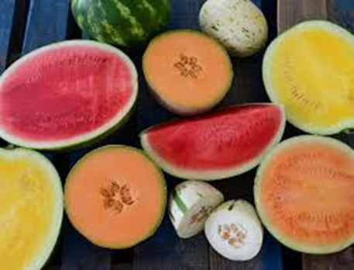
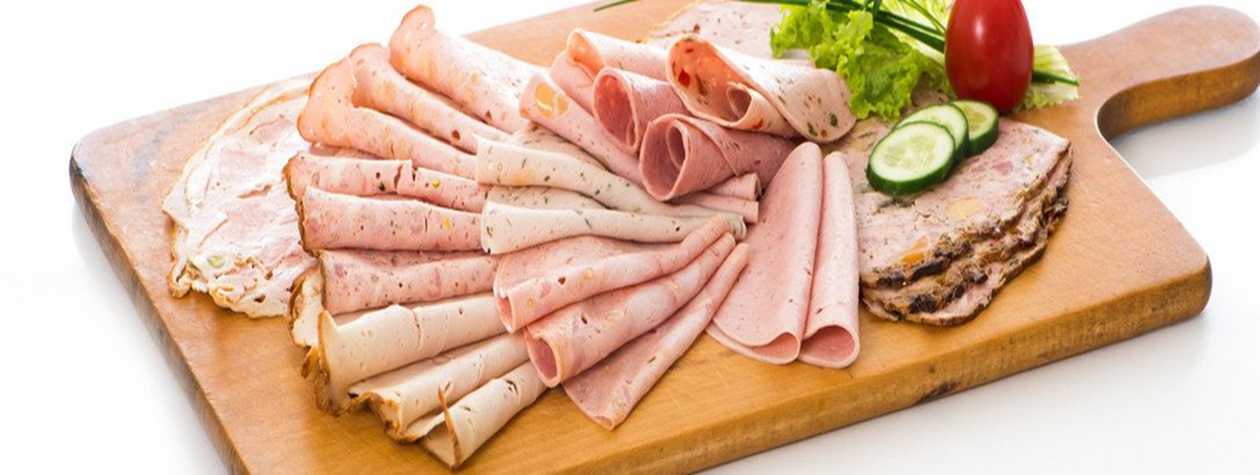
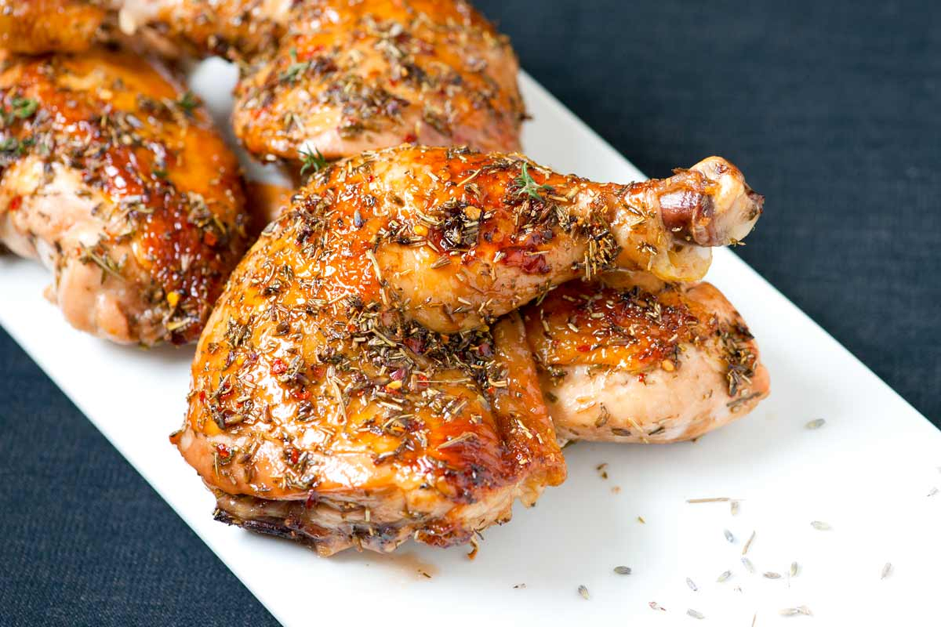
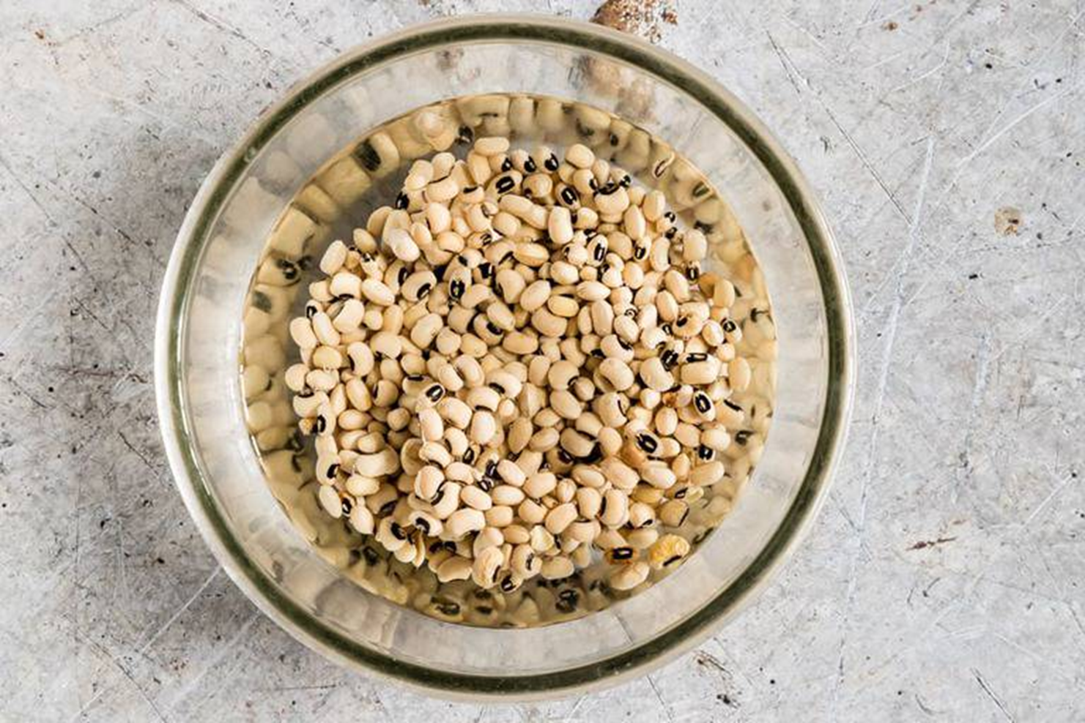
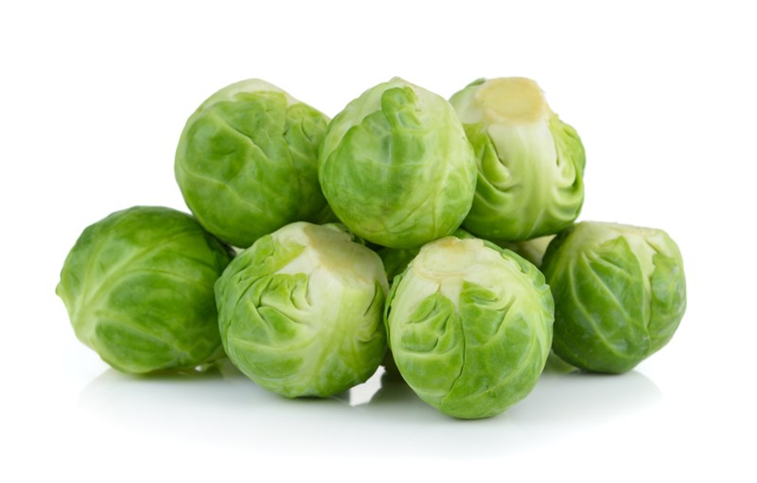
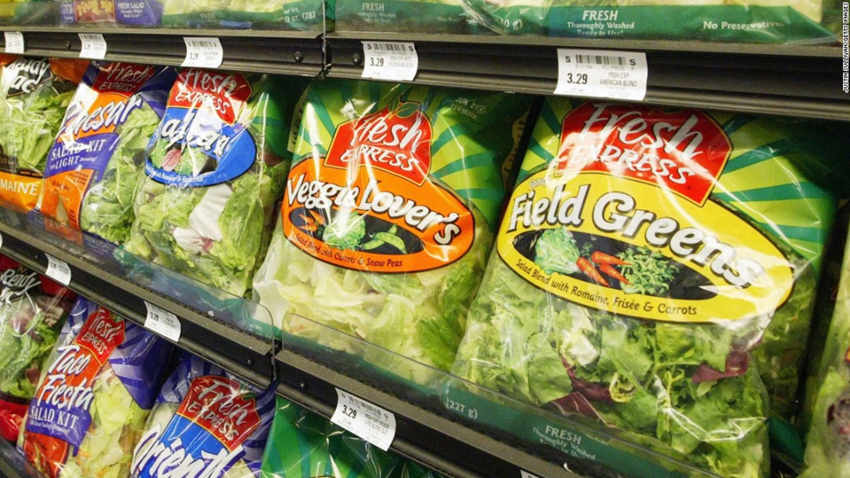
Deli Meat: TCS
Cut melon: TCS
Roasted Chicken: TCS
Beans soaking in water: NOT TCS
Is this food TCS?
Whole Brussels Sprouts: NOT TCS
Bagged salad greens: TCS

Slide 6
TCS General Rules:
TCS
NOT TCS
Raw animal foods
Cooked animal foods
Raw garlic in oil
Raw, CUT tomatoes, leafy greens, and melons
Cooked plant foods
Raw plant foods
Raw, WHOLE tomatoes, leafy greens, and melons
Cured and/or dried animal products

Slide 7
Purchasing Food From Unsafe Sources
  Reheating Foods
  Sanitizing Food Contact Surfaces
  Cooling Foods
Dirty/ Contaminated Equipment
Improper Holding Times and Temperatures
  Hot-Holding Foods
Common Critical Violations
  Cold-Holding Foods
  Employee Health
  Datemarking
  Improper Cooking
Poor Personal Hygiene
Contamination
  Improper
  Handwashing
  Chemical Storage
  Bare Hand Contact with Ready-to-Eat Foods
  Refrigerated Storage

Slide 8
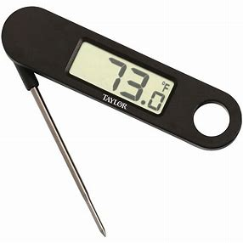
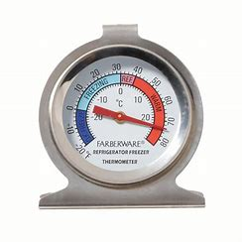

TCS Food Storage Temperatures
Cold-Holding
Hot-Holding
Foods must have an internal temperature at or below 41F.
Refrigerators must have the proper capacity to ensure adequate air flow to keep foods cold.
Must have thermometers in every refrigerator for measuring the ambient air temperature.
Check refrigerator air temperatures twice per day.
Keep refrigeration logs.
Foods must have an internal temperature at or above 135F.
Equipment must have the proper capacity to keep foods hot.
Frequently stir hot foods to circulate heat throughout the product.
Check hot-holding temperatures at least once every 2 hours.
Check the water level of steam tables.
Keep hot-holding logs.
135F and above
Temperature Danger Zone
41F-135F
41F and below
Notes:
Questions for this slide:
1. Who can tell me what the proper cold-holding temperature is?
2. Who can tell me what the proper hot-holding temperature is?
3. Everything in-between is considered the temperature danger zone.
4. How often should you check the temperature of your refrigerators?
5.How often should you check the temperature of hot-held items?
6-7.What are two pieces of equipment that every kitchen must have to verify proper temperatures?

Slide 9
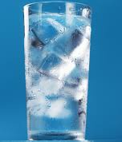
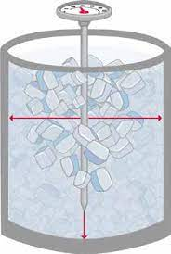
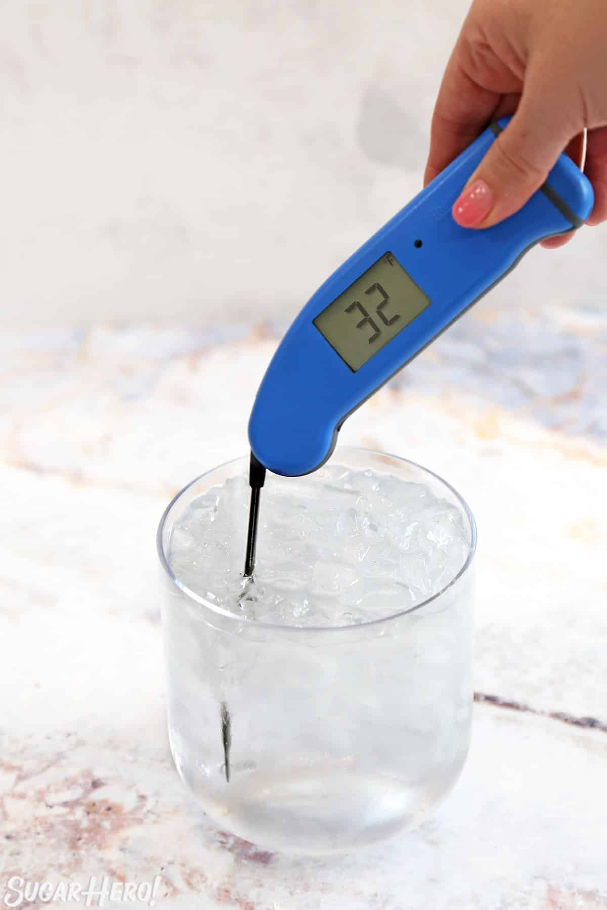
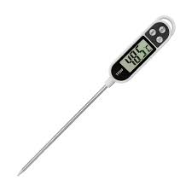
Calibrating Thermometers
Fill a cup with ice and cold water.
Insert the thermometer in the ice water.
Thermometer should measure a temperature of 32F.
If thermometer reads a temperature other than 32F, adjust the thermometer according to the manufacturer’s instructions.
Notes:
Raise your hand if you already know how to calibrate a thermometer. Randomly call on someone to tell us their process.
2. After you insert the thermometer, what temperature do you want the thermometer to measure?
3. What corrective action should you take if the thermometer doesn’t measure 32F?

Slide 10
Cooking & Reheating Temperatures
TOP SHELF
Reheat temperature for TCS foods made on-site that will be held hot.
Poultry
Stuffed Food
165°F
155°F
Tenderized/injected meats
Ground meats
Raw shell eggs that will be held hot
145°F
Fish and Seafood
Raw shell eggs for immediate service
Whole muscle meat and pork
Whole muscle roasts of meat or pork may be cooked to 130°F / 54.4°F. Temperature must be maintained for 112 minutes.
Proper Refrigerator Storage
135°F
Cook temperature of fruits, vegetables, and grains that will be held hot
Reheat temperature for commercially manufactured TCS Foods
Minimum temperature required for hot-holding food items
Temperature Danger Zone: 41°F to 135°F
≤ 41°F
Food that is being held cold
All frozen food must be kept frozen solid
BOTTOM SHELF
Notes:
Questions for this slide:
1.
2.
3.
4.
5.
6.
7.
8.

Slide 11




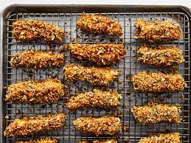
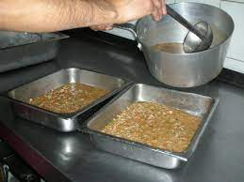
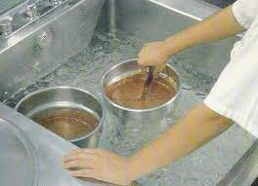
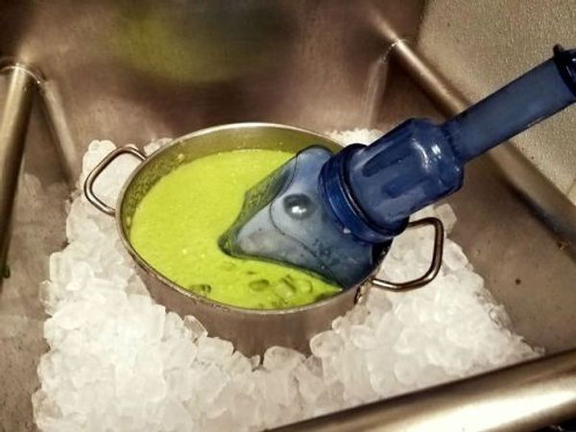
Cooling
Cooling starts when the food temperature reaches 135F.
Food temperature must be 70F within 2 hours of starting the cooling process.
Food temperatures must reach 41F within the next 4 hours.
Food must be completely cooled within 6 hours.
Cooling Methods:
Always leave food uncovered until completely cooled.
Use metal pans and portion products into single or shallow layers.
Place products in the refrigerator, freezer, or an ice bath and stir frequently.
Use ice paddles or add ice to the product, if possible.
Check temperatures every 2 hours.
Notes:
Questions:
10. How often should you check the temperature of food items in the cooling process?

Slide 12
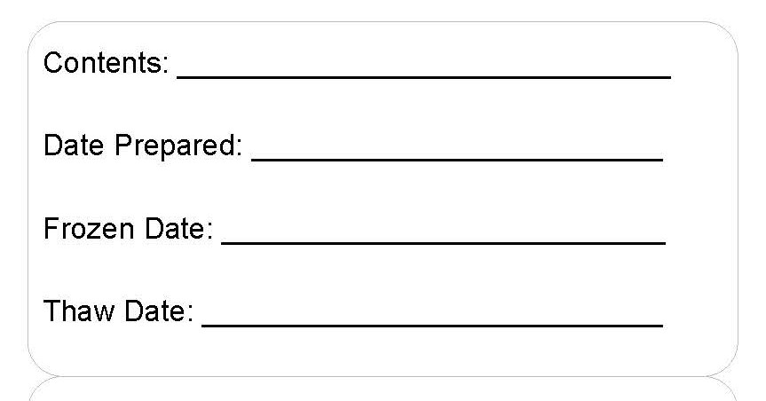
Datemarking
Shredded Chicken
1/10
1/16
All TCS foods that are prepared on-site or opened from a commercial package must be datemarked if they are held for more than 24 hours.
All TCS foods must be used or discarded within 7 days.
The date of preparation/ package opening is day 1 of 7.
Freezing the product pauses the 7 days, but does not restart the 7 days.
Exceptions: cultured dairy, hard cheeses, cured meats, raw meats.
1/12
2/14
2/17
Day 1 | 1/10 | Preparation
Day 2 | 1/11
Day 3 | 1/12 | Freeze
Day 4 | 2/14 | Thaw
Day 5 | 2/15
Day 6 | 2/16
Day 7 | 2/17 | Discard
Notes:
Shredded Chicken:
Prepared on 1/10. If the product is not frozen, what date does it need to be used by? 1/16
Now let’s say that the shredded chicken was frozen on 1/12 and was thawed a month later on 2/14. What date does it need to be used by?

Slide 13
Food Item | Does it need a datemark?
Grilled Chicken | YES
Raw, ground beef | NO
One gallon of whole milk | YES
Plain Greek yogurt | NO
Opened, canned green beans | YES
Grated parmesan cheese | NO
Open package of salami | NO
Unopened bagged salad | NO
Opened bagged salad | YES

Slide 14
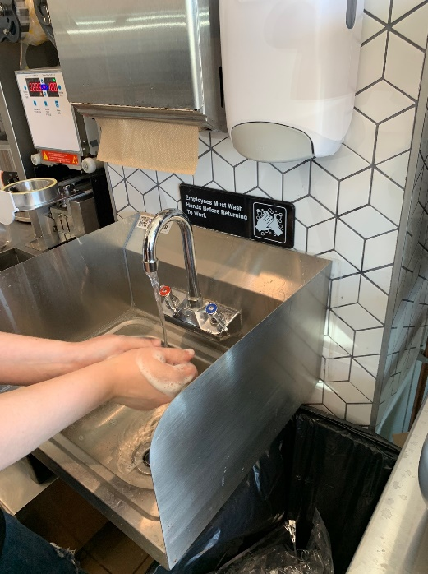
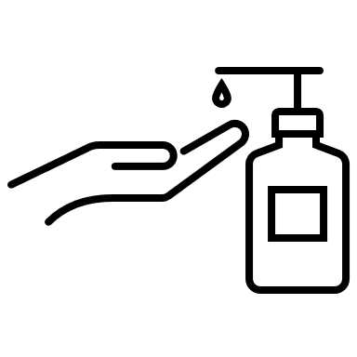


Handwashing
WHEN
Immediately before:
  Beginning food preparation,
  Putting on a new pair of single-use gloves for working with food,
  Handling clean equipment and utensils
Immediately after:
  Touching eyes, face, nose, mouth, etc.
  Touching clothing or personal items
  Using the restroom
  Coughing, sneezing, using a handkerchief or tissue, using tobacco, eating, or drinking
  Handling areas of high contamination
  Handling soiled equipment or utensils
  Engaging in other activities that may contaminate hands
Between changing tasks
Between handling dirty dishes and handling clean dishes
As often as necessary to remove food debris or other contaminants
HOW
Remember:
Hand sanitizer does not replace a full and proper hand wash!
Hand sanitizer cannot be used in place of liquid hand soap!
Only wash hands in sinks that are designated and used exclusively for hand washing.
Use warm water and liquid soap and wash hands for a minimum of 20 seconds.
Use clean paper towels to dry your hands and use the paper towel to turn of the sink.
Notes:
Questions:
Each table should state a time in which they are expected to wash their hands.
Can you use hand sanitizer instead of washing your hands after taking out the trash?

Slide 15



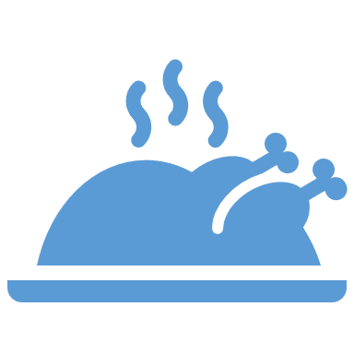

Preventing Bare-hand Contact with Ready-to-eat Foods
Bare-hand contact with ready-to-eat food can spread illness and contamination.
Prevent bare-hand contact by using single-use gloves or utensils.
Only raw foods that will be properly cooked can be handled with bare hands.
Once a food is cooked it is considered ready-to-eat and must NOT be handled with bare hands.
Garnishes for plates and drinks must NOT be handled with bare hands.
Notes:
Questions:
I cooked shredded chicken but I know that it will be cooked again when I add it to a burrito. Can I touch the chicken before I add it to the burrito?
The waitstaff usually garnishes plates before they bring it out to a customer. Can they use their bare hands to add the garnish?

Slide 16





Cleaning Food Contact Surfaces
Wash
Food contact surface must be completely submerged in the basin of the 3-compartment sink.
Use dish detergent and water with a minimum temperature of 110F.
Replace the water when it becomes visibly dirty with food debris or grease.
Food contact surface must be completely submerged in the basin of the 3-compartment sink.
Use clean, hot water.
Replace the water as needed to ensure that all the detergent is washed away.
Rinse
Food contact surface must be completely submerged in the basin of the 3-compartment sink.
Follow the manufacturer’s instructions for water temperature and safe concentration.
Use test strips to verify concentration.
Sanitize
STOP:
DO NOT RINSE AGAIN AFTER THE SANITIZER
Air Dry
Allow food contact surfaces to completely air dry before use.
Do not use a towel to dry any food contact surfaces.
Notes:
Questions:
5. After the sanitize step, should you rinse the dishes again before allowing them to air dry?

Slide 17
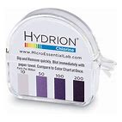
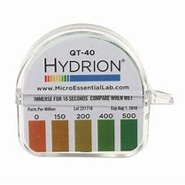
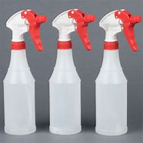
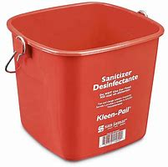
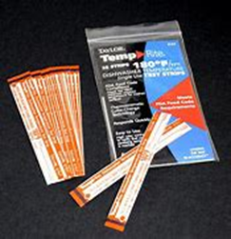
Cleaning Food Contact Surfaces
Clean-in-place
Sanitizer Buckets
Sanitizer Test Strips
Same steps: wash, rinse, sanitize, air dry.
Use spray bottles and clean wiping cloths.
Must be separate from or beneath food storage.
Check the concentration: too much can lead to chemical contamination of food.
Check and/or replace every two hours.
Chlorine
  50ppm – 100ppm
Quat Ammonia
  200ppm – 400ppm
High Temperature: 160F at the plate level.
Sanitizer test strips are required regardless of the type of sanitizer you use.
ALWAYS LABEL CHEMICAL SPRAY BOTTLES!
Notes:
Questions:
What is the required concentration for chlorine sanitizer?
What is the required concentration for quat ammonia sanitizer?
What is the required temperature for high temperature dishwashers?
What type of test strips do you need if you have a high temperature dishwasher?
There is a violation in one of the pictures on the screen, can anyone guess what it is?

Slide 18
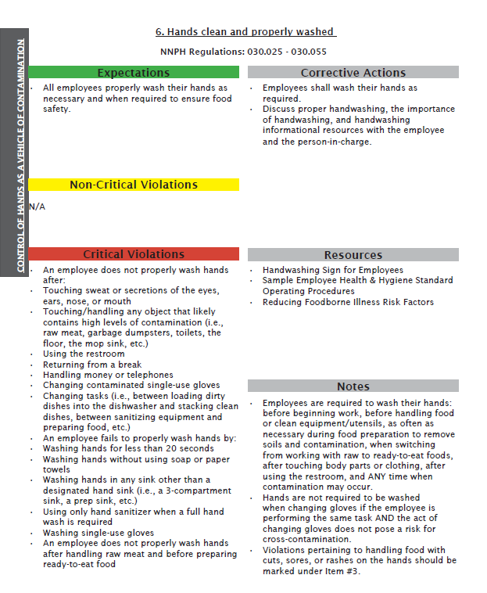
Food Safety Field Inspection Guide

Slide 19
Questions

